Slide 1
DR SNSRCAS, CBE Software Engineering 21UCA408 II BCA B UNIT I Agile Modeling

Slide 2
Agile Modeling
The meaning of Agile is swift or versatile."Agile process model" refers to a software development approach based on iterative development. Agile methods break tasks into smaller iterations, or parts do not directly involve long term planning. The project scope and requirements are laid down at the beginning of the development process. Plans regarding the number of iterations, the duration and the scope of each iteration are clearly defined in advance.
Each iteration is considered as a short time "frame" in the Agile process model, which typically lasts from one to four weeks. The division of the entire project into smaller parts helps to minimize the project risk and to reduce the overall project delivery time requirements..

Slide 3
Agile Modeling
Each iteration involves a team working through a full software development life cycle including planning, requirements analysis, design, coding, and testing before a working product is demonstrated to the client. The division of the entire project into smaller parts helps to minimize the project risk and to reduce the overall project delivery time requirements. Each iteration involves a team working through a full software development life cycle including planning, requirements analysis, design, coding, and testing before a working product is demonstrated to the client.

Slide 4
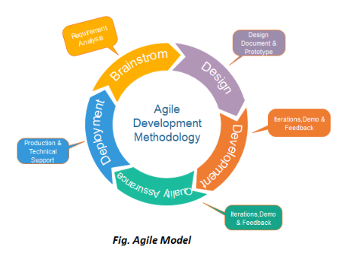
Agile Modeling

Slide 5
Agile Modeling
Phases of Agile Model:
Following are the phases in the Agile model are as follows:
Requirements gathering
Design the requirements
Construction/ iteration
Testing/ Quality assurance
Deployment
Feedback

Slide 6
Agile Modeling
Requirements gathering: In this phase, you must define the requirements. You should explain business opportunities and plan the time and effort needed to build the project. Based on this information, you can evaluate technical and economic feasibility.
2. Design the requirements: When you have identified the project, work with stakeholders to define requirements. You can use the user flow diagram or the high-level UML diagram to show the work of new features and show how it will apply to your existing system.
3. Construction/ iteration: When the team defines the requirements, the work begins. Designers and developers start working on their project, which aims to deploy a working product. The product will undergo various stages of improvement, so it includes simple, minimal functionality.
4. Testing: In this phase, the Quality Assurance team examines the product's performance and looks for the bug.

Slide 7
Agile Modeling
5. Deployment: In this phase, the team issues a product for the user's work environment.
6. Feedback: After releasing the product, the last step is feedback. In this, the team receives feedback about the product and works through the feedback.
Agile Testing Methods:
Scrum
Crystal
Dynamic Software Development Method(DSDM)
Feature Driven Development(FDD)
Lean Software Development
eXtreme Programming(XP)

Slide 8
THANK YOU

